Slide 1
Bird Sound
Classifier
Hanpu Liu

Slide 2
Table of contents
01
02
03
04
Background
Technical overview
An overview and motivation of the project
a technical overview of what have been implemented
Learning
Improvements
Lessons learnt on the journey
Improvements would been made if time permitted

Slide 3
01
Background

Slide 4
—Hiral Nagda
“Birds chirping around you is a beautiful realization that life is incredibly good. Let this sound be a gentle break in your routine.”

Slide 5
02
Technical overview

Slide 6

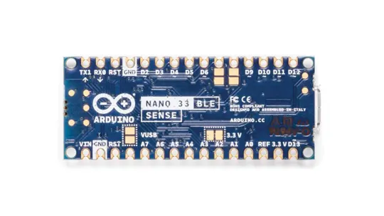
Tools

Slide 7
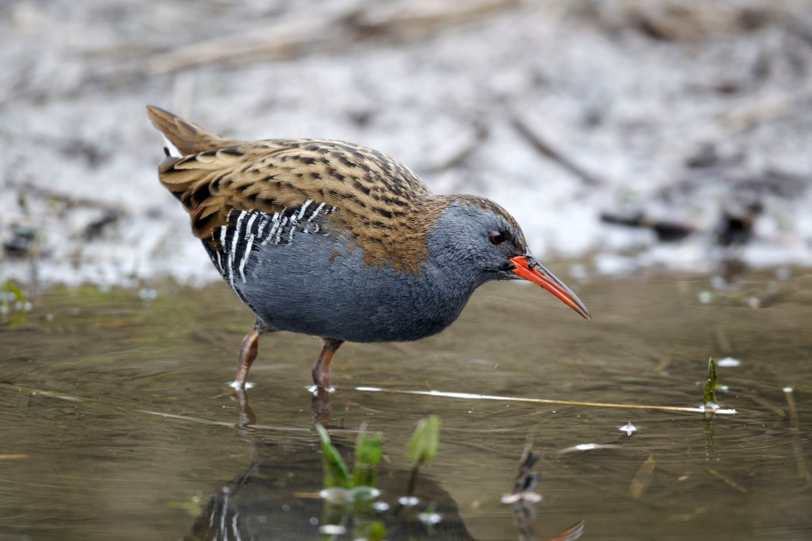
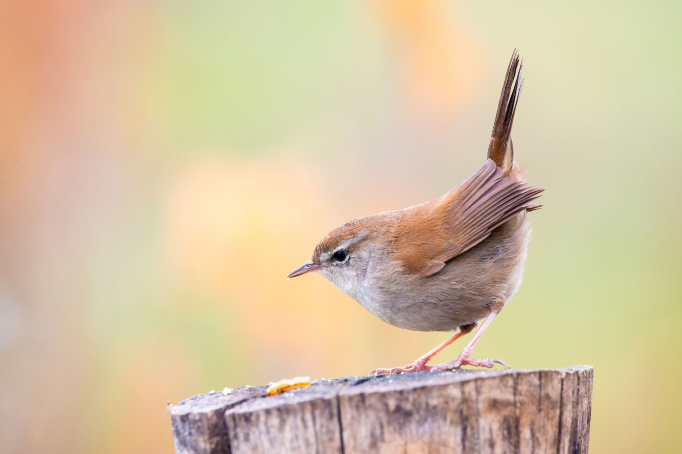
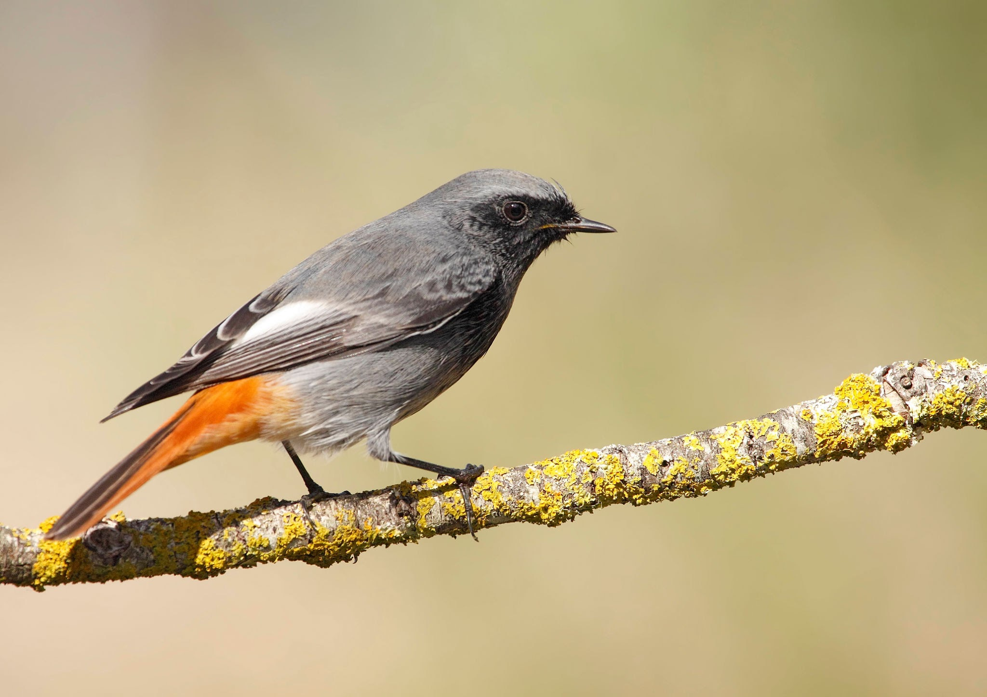
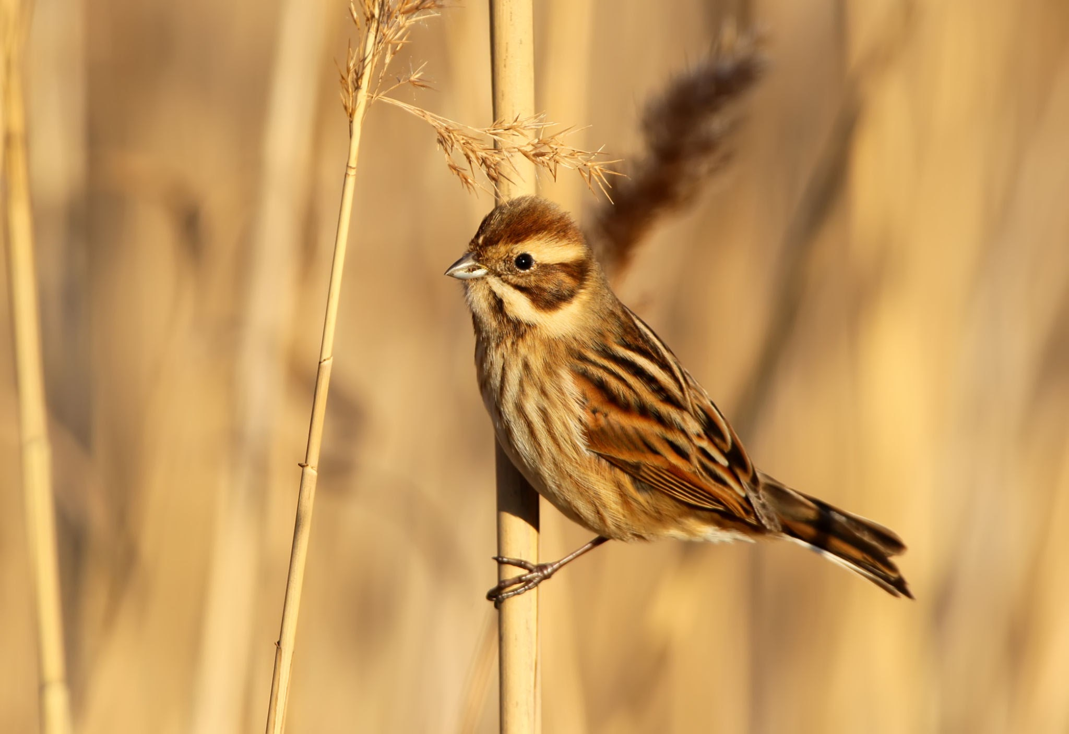
Building a Dataset
Water rail
Cetti's warbler
Black redstart
Common reed bunting
Rallus aquaticus
Cettia cetti
Phoenicurus ochruros
Emberiza schoeniclus

Slide 8
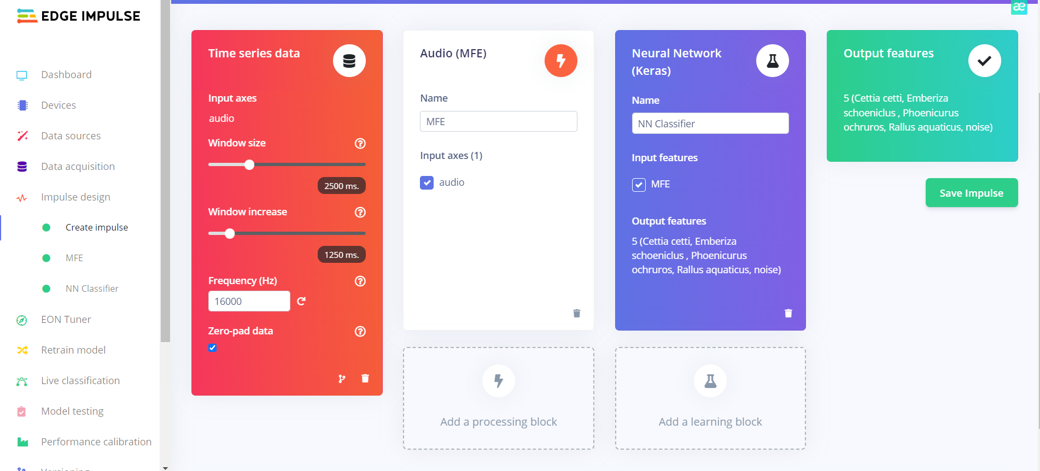
Designing an Impulse

Slide 9
Demo Videos

Slide 10
03
Learning

Slide 11
Lessons learnt on the journey
01
02
03
Theoretical knowledge
Hands-on experience
Independent thinking

Slide 12
04
Improvement

Slide 13
Model fusion
Hyperparameter tuning
Multimodal information

Slide 14
Thanks!

